Slide 1
YOLOv4 vs v4 Tiny
Comparison and Benchmark

Slide 2
YOLO v4 - Inference Options
Official Darknet - CUDA (GPU) / OpenMP (CPU)
OpenCV - DNN
PyTorch / TensorFlow Model

Slide 3
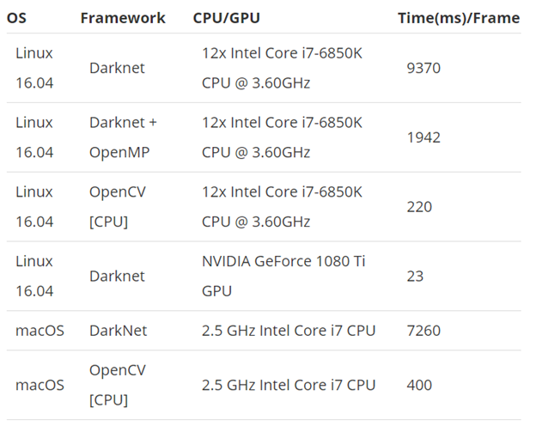
YOLO v4 - Benchmark
OpenCV - DNN on Intel Core i7-6850K
= 220 ms / Frame
= 4.55 FPS

Slide 4
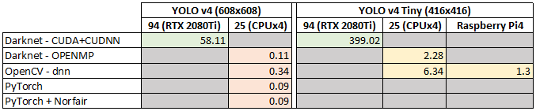
YOLO v4: COCO pre-trained model

Slide 5
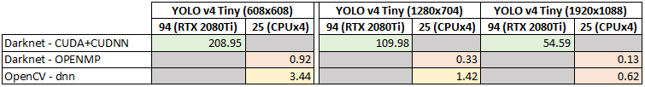
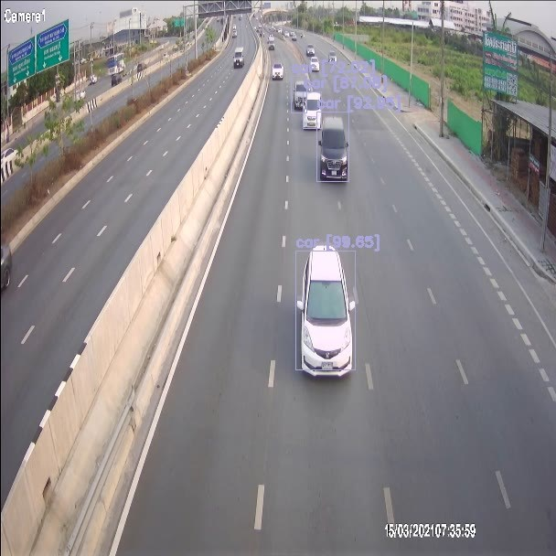
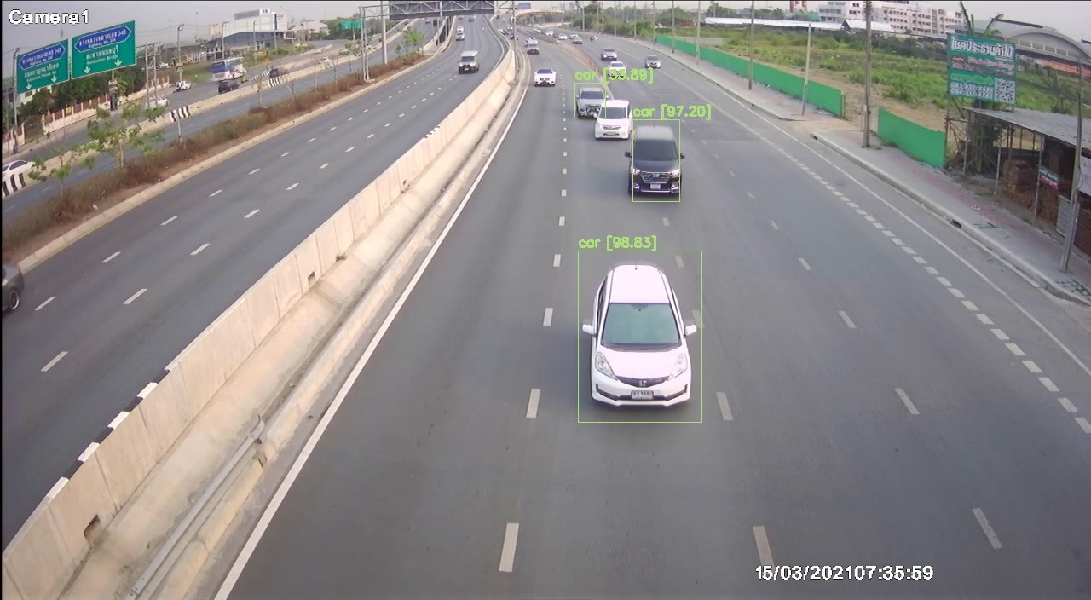
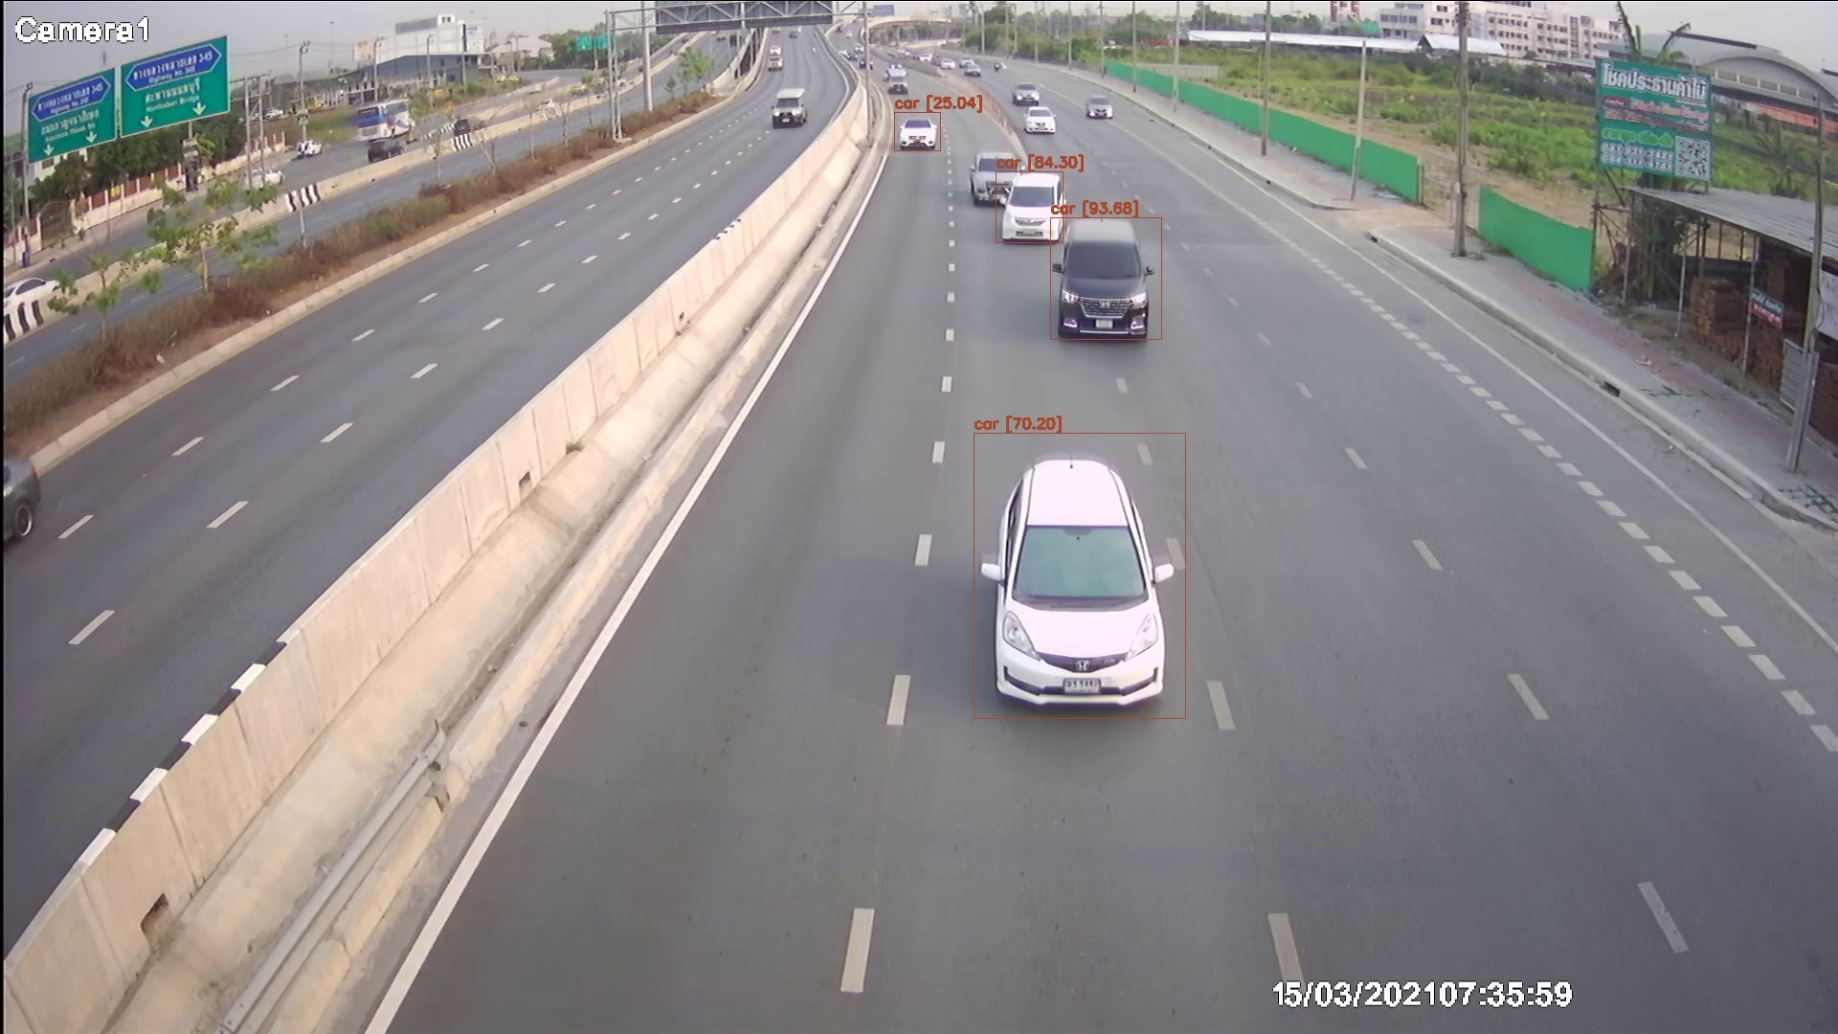
YOLO v4: Custom model (Vehicle 15 types)
HD
FullHD

Slide 6
Accuracy Comparison
COCO pre-trained Model: YOLO v4 vs YOLO v4 Lite
YOLO v4 (COCO) vs YOLO v4 Tiny (Custom)

Slide 7
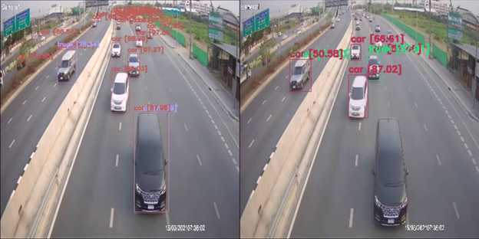
COCO: YOLOv4 vs YOLOv4 Tiny
Difference in Size: YOLO v4 (608x608) vs YOLO v4 Lite (416x416)

Slide 8
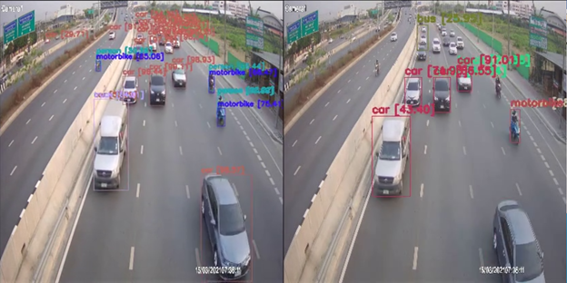
COCO: YOLOv4 vs YOLOv4 Tiny

Slide 9
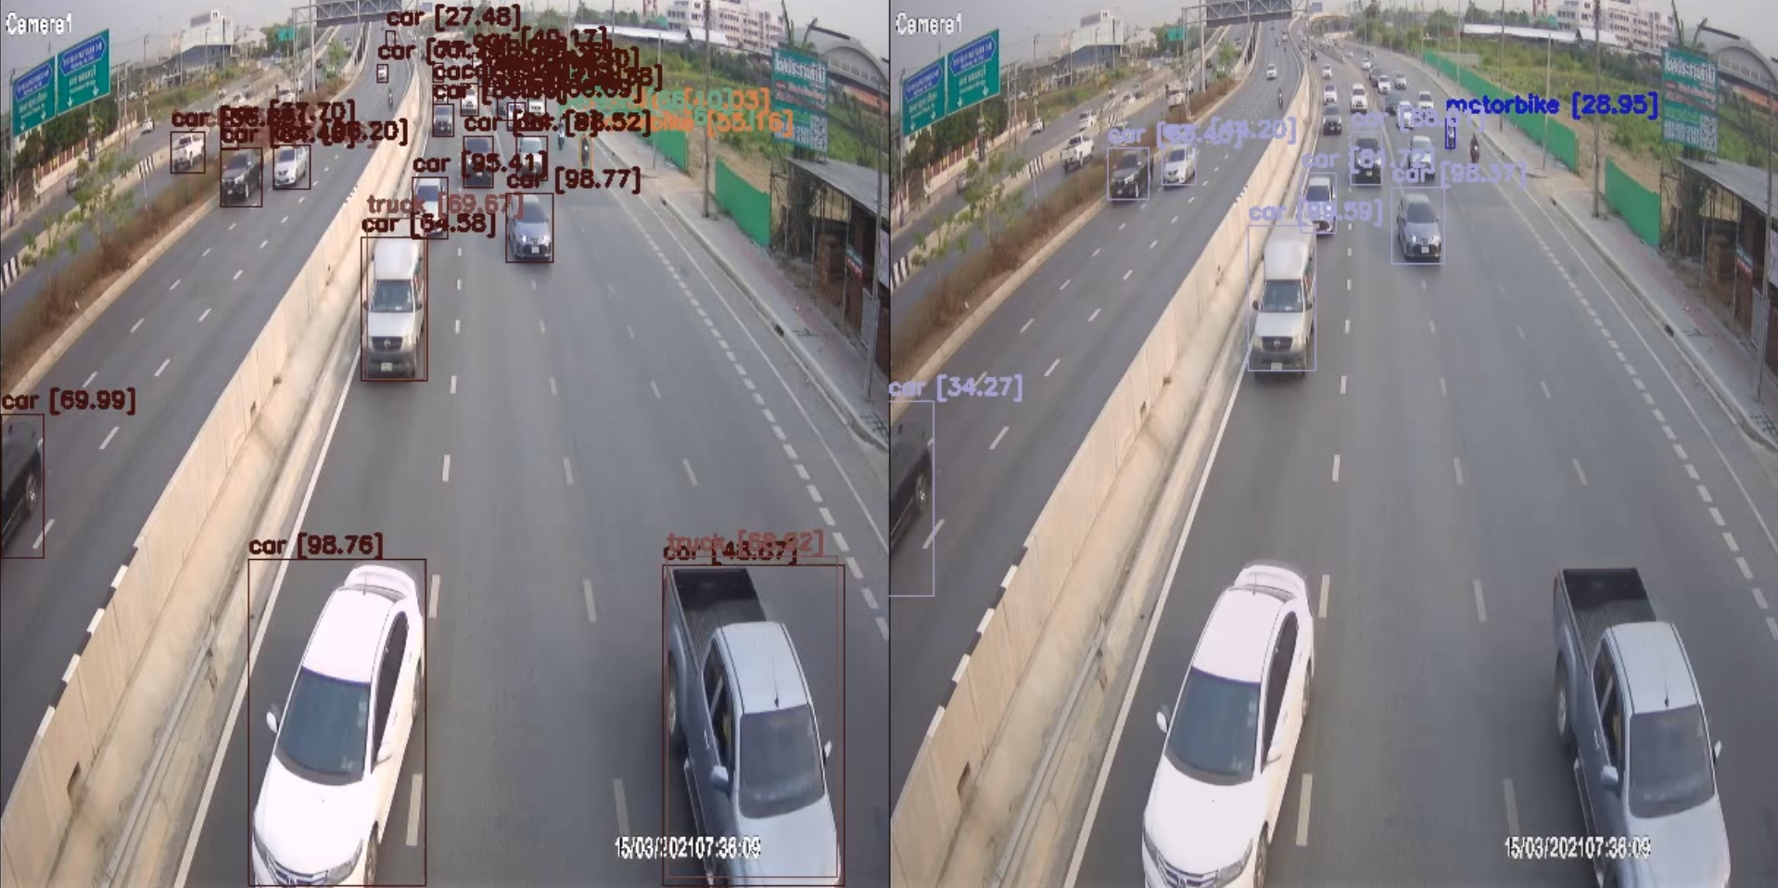
YOLOv4 (COCO) vs YOLOv4 Tiny (Custom)
Same size (608x608), different Architecture and Dataset

Slide 10
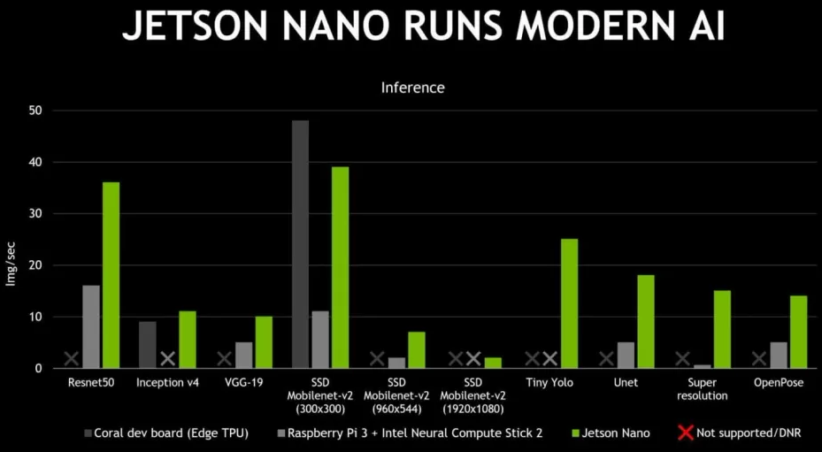
Possible Edge Computing ?

